Slide 1

GAME DEV WITH ALLEGRO 5
Game Loop

Slide 2
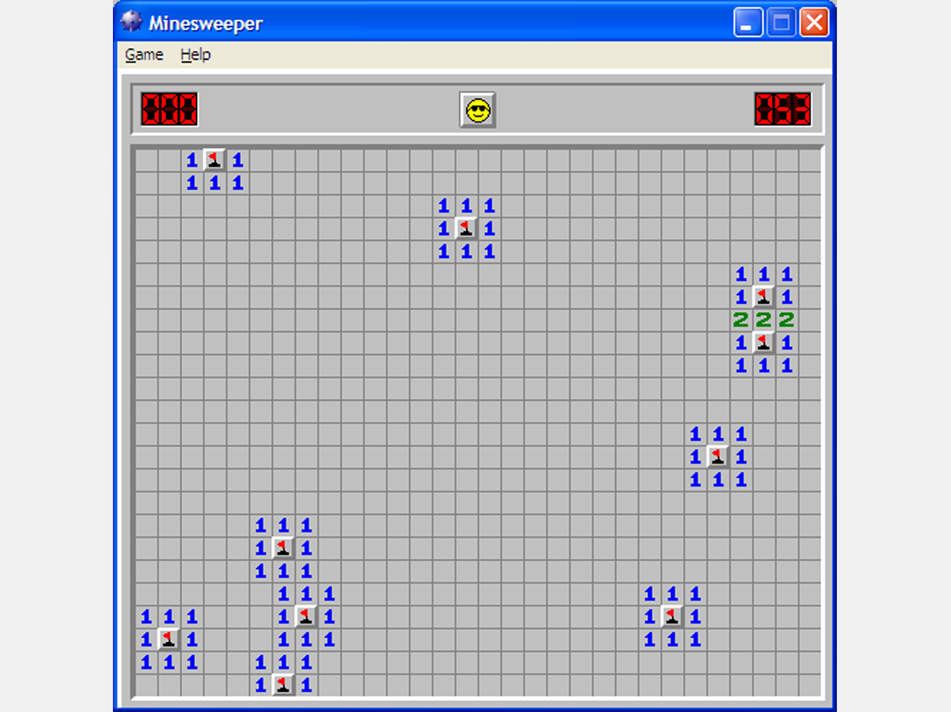
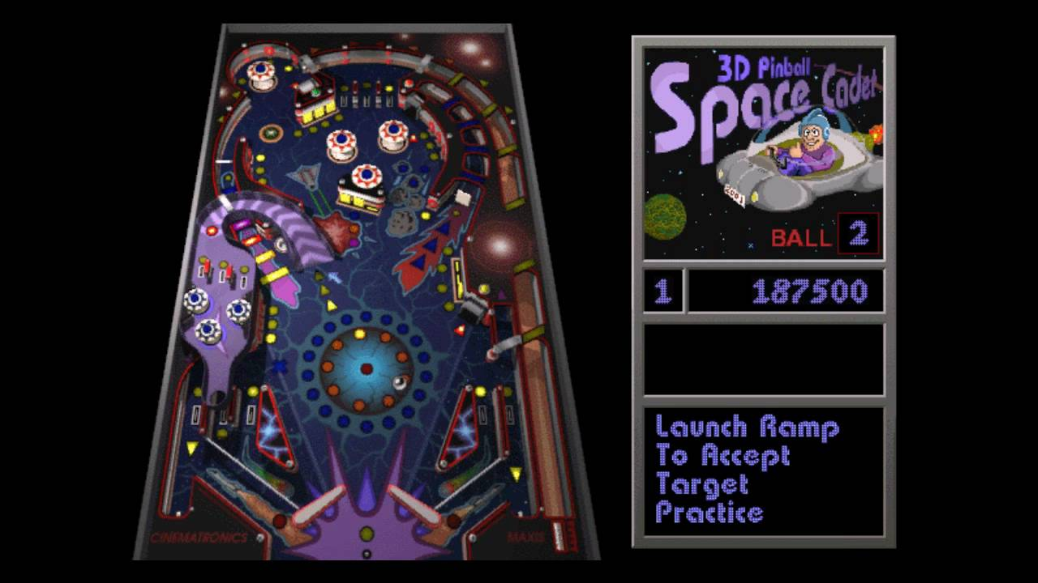
What is a Game Loop
A loop that allows your game to appear for a long time until the player terminates the game
We will not learn how to implement code to close the window in this video
We will also not learn keyboard input

Slide 3
How to implement the Game Loop
Declare a boolean variable and set it to true/false
ex. bool isrunning = true or bool done = false
Use a while loop and put the boolean variable in the condition
ex while (isrunning) or while (!done)
So it goes like this
bool isrunning = true;
while (isrunning)
{//clear to color
//shape
//flip display}
OR
bool done = false;
while (!done)
{//clear to color
//shape
//flip display}

